Slide 1
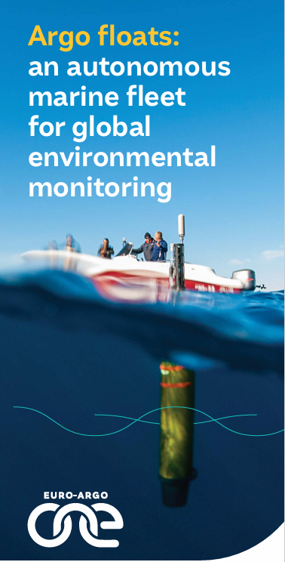


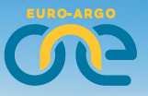

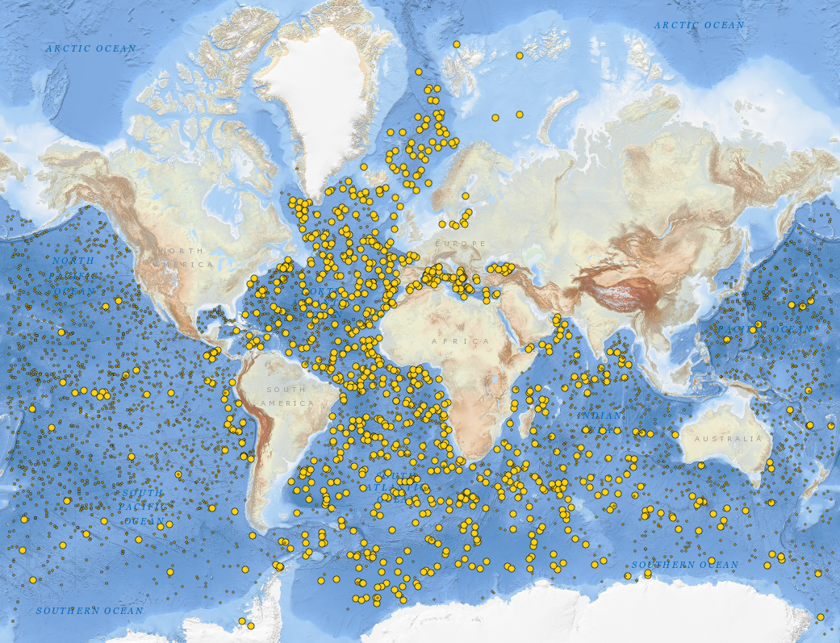

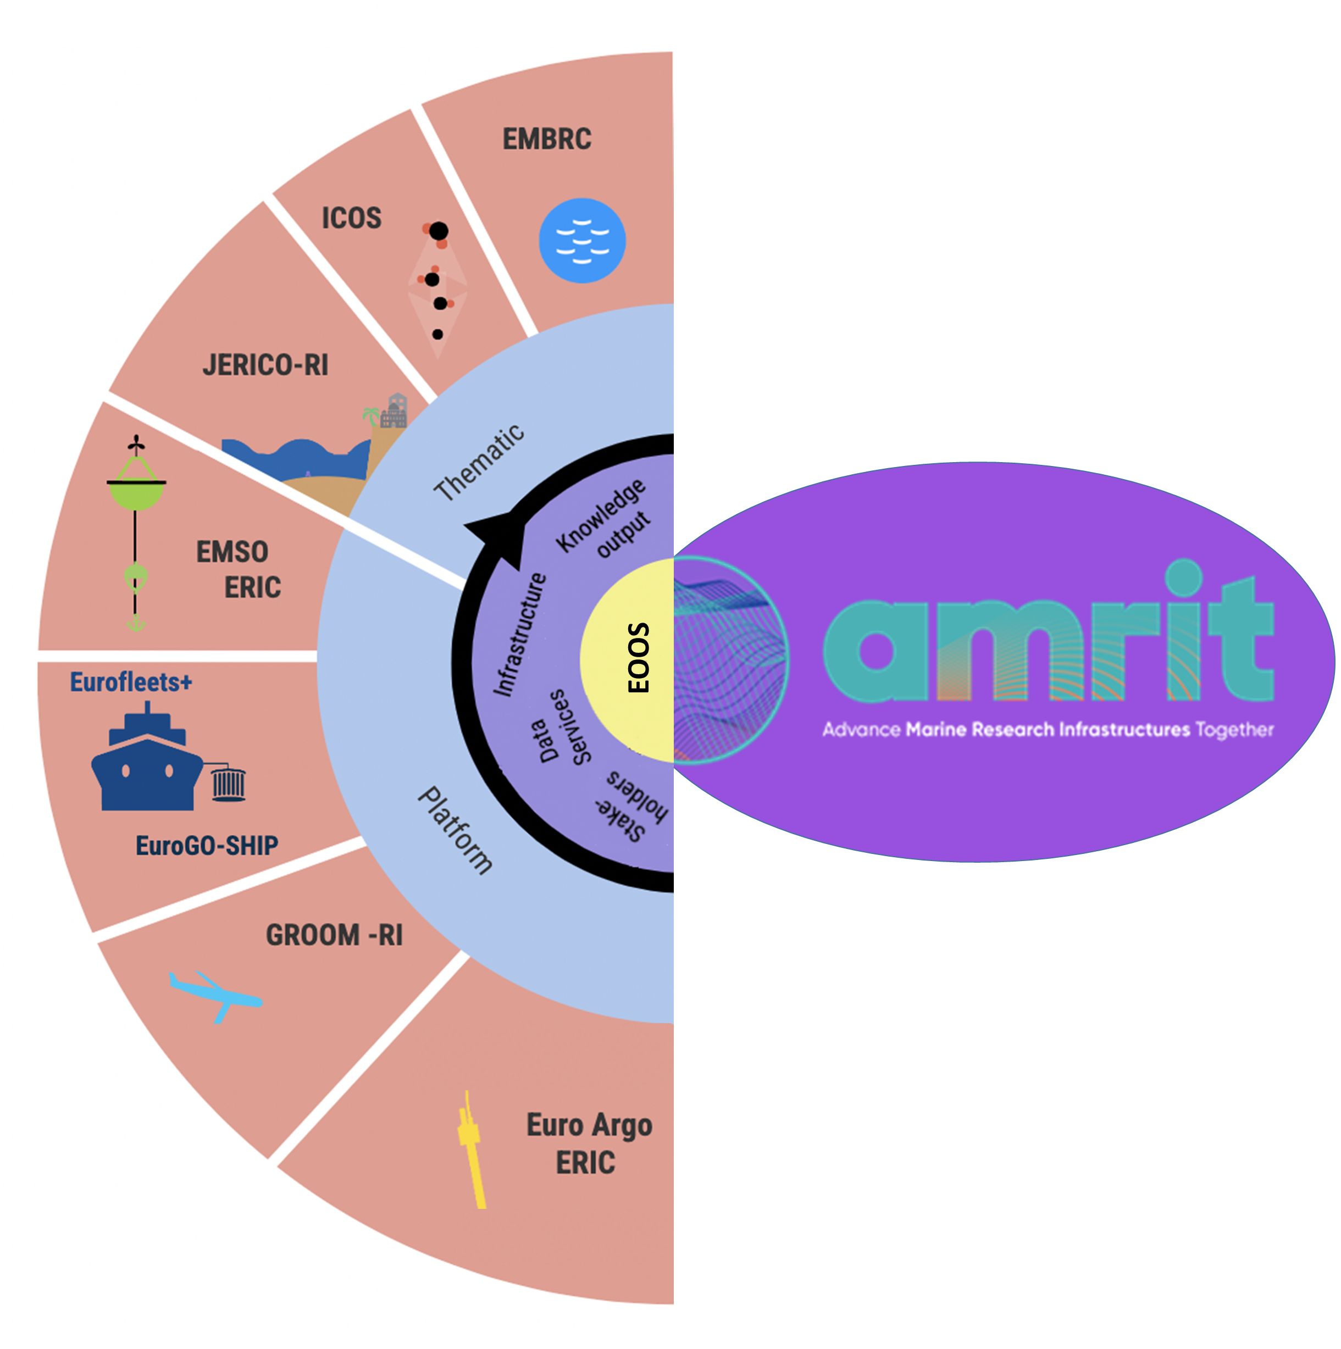

BIOLOGY DEPARTMENT
The European Ocean Observing System – Argo floats: an autonomous oceanographic fleet for global environmental monitoring
Dr. Dimitris Kassis - Physical Oceanographer
Institute of Oceanography – Hellenic Centre for Marine Research
Παρασκευή 8 Μαΐου

